Slide 1
Streaming Data Applications
Unit 5
Dr. Yousefi

Slide 2
Objectives
Analyze the delivery of streaming data to other applications and visualization tools.
Demonstrate an understanding of streaming data analytics principles while examining case studies and learning about applicable tools to reinforce the concepts.
Recognize different types of big data and streaming data sources and how to use them in strategic and operational decisions.

Slide 3
Assignments
Unit 5 - Discussion Board (75 points)
Unit 5 - Individual Project (125 points)
Unit 5 - Live Chat Extra Credit Summary (15 points)

Slide 4
Discussion
Review and reflect on the knowledge you have gained from this course. Based on your review and reflection, write at least 300-500 words on the following:
What were the most compelling topics learned in this course?
How did participating in discussions help your understanding of the subject matter? Is anything still unclear that could be clarified?

Slide 5
IP
Creating a pipeline that ingests, stores, cleans, prepares, and makes predictions is common within a big data ecosystem.
Many companies do this on a very large scale and across many business functions and products.
During Week 5, you will construct an end-to-end solution that ingests, stores, and predicts market orders.
The data to use are located at https://www.pubnub.com/developers/realtime-data-streams/financial-securities-market-orders/
Go to solution and data streaming

Slide 6
IP
The project deliverables include the following:
Ingest the data from
https://www.pubnub.com/developers/realtime-data-streams/financial-securities-market-orders/ using tools such as Python.
Construct a predictive analytics solution using Python libraries (such as Scikit-Learn) to predict future market orders.
The submission should include the code to connect, ingest, predict, and interpret.
Provide the code and a discussion on the aspects of design, including endpoint connection, the ingesting approach, the prediction algorithm, and interpretation.
Additionally, discuss how the algorithm could be optimized, such as with feature engineering.

Slide 7
How to Make Predictions with scikit-learn in Python
How to Install “scikit-learn” :
and scikit-learn version,
sklearn.__version__
'0.22’
In Windows :
pip install scikit-learn
In Linux :
pip install --user scikit-learn

Slide 8
EX
Importing scikit-learn into your Python code
import sklearn

Slide 9
How to predict Using scikit-learn in Python:
scikit-learn can be used in making the Machine Learning model, both for supervised and unsupervised ( and some semi-supervised problems) to predict as well as to determine the accuracy of a model!
An overview of what scikit-learn modules can be used for:
To solve Regression problems (Linear, Logistic, multiple, polynomial regression)
Fit and Evaluate the model
For pre-processing a data available
In feature extraction from categorical variables
For Non-Linear Classification (in Decision Trees)
In Clustering analysis

Slide 10
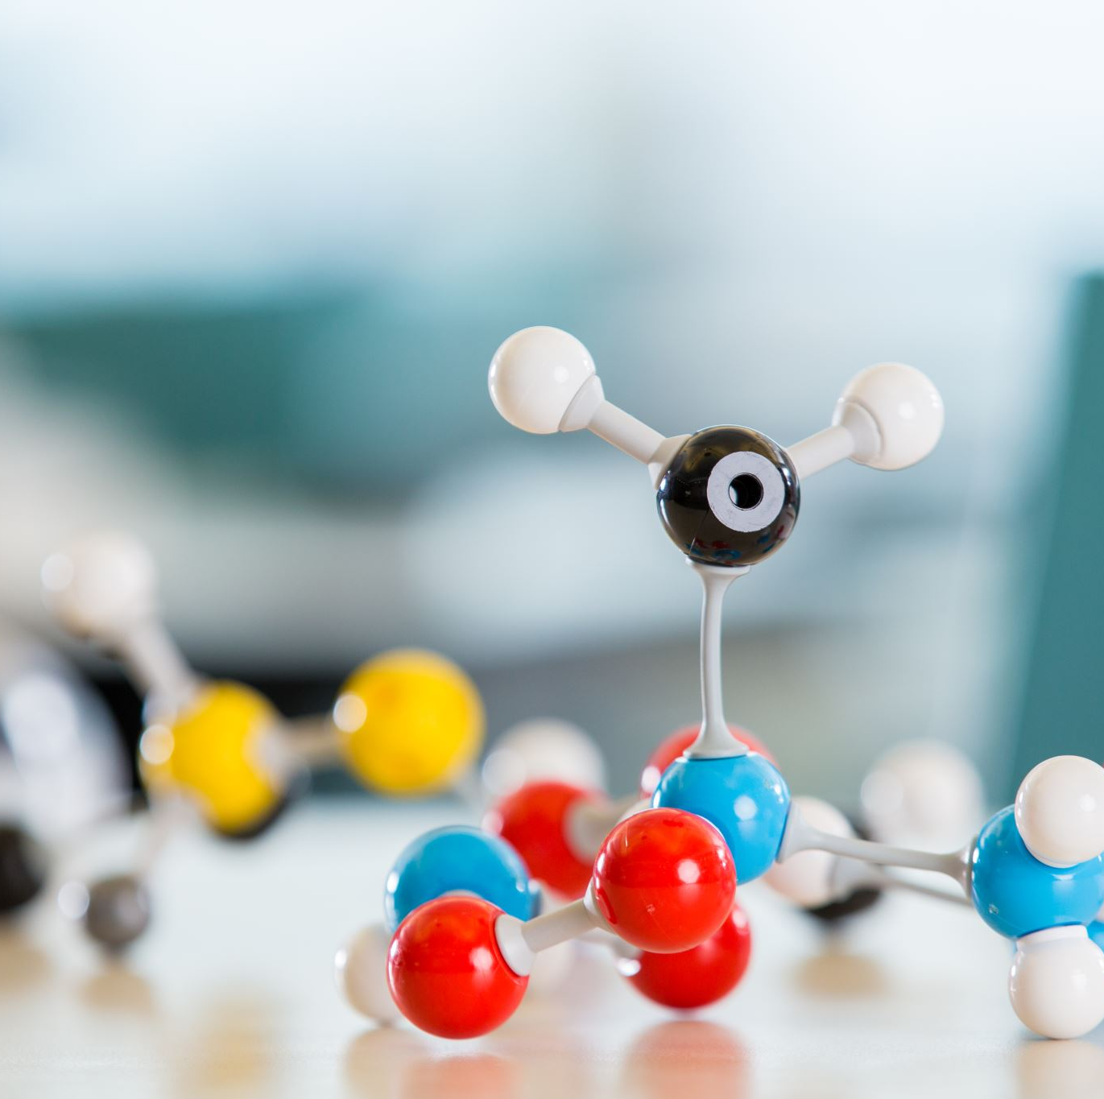
How to Make Predictions with scikit-learn
First, Finalize Your Model
How to Predict With Classification Models
How to Predict With Regression Models

Slide 11

First Finalize Your Model
Before you can make predictions, you must train a final model.
You may have trained models using k-fold cross-validation or train/test splits of your data. This was done in order to give you an estimate of the skill of the model on out-of-sample data, e.g. new data.

Slide 12

How to Make Predictions with scikit-learn
These models have served their purpose and can now be discarded.
You now must train a final model on all of your available data.
You can learn more about how to train a final model here:

Slide 13
How to Predict With Classification Models
Classification problems are those where the model learns a mapping between input features and an output feature that is a label, such as “spam” and “not spam.”
Below is a sample code of a finalized LogisticRegression
model for a simple binary classification problem.

Slide 14
How to Predict With Classification Models
How do I predict with cross-validation?
Which model do I choose from cross-validation?
Do I use the model after preparing it on the training dataset?

Slide 15

sklearn.model_selection.cross_val_predict
sklearn.model_selection.cross_val_predict(estimator, X, y=None, *, groups=None,
cv=None, n_jobs=None, verbose=0, fit_params=None, pre_dispatch='2*n_jobs', method='predict')

Slide 16
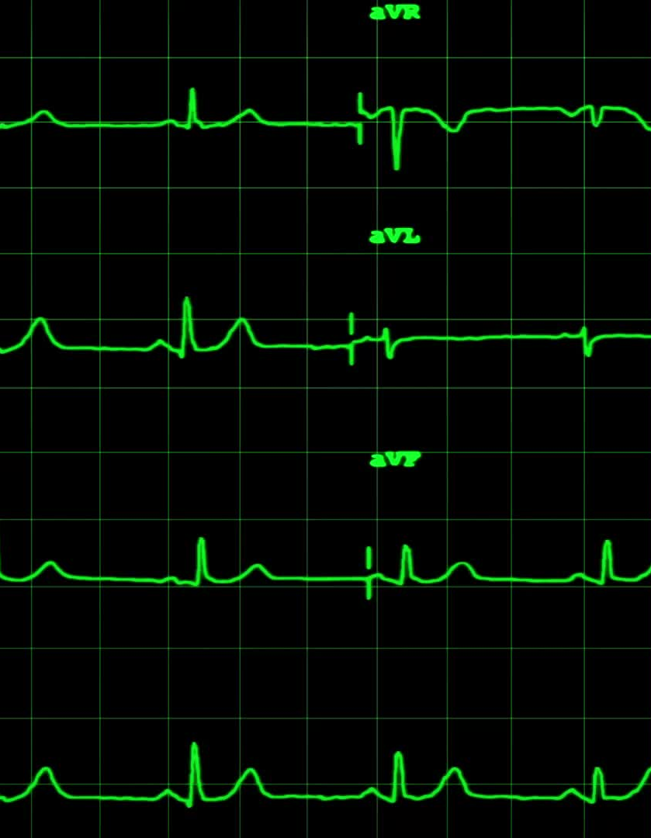
Examples
>>> from sklearn import datasets, linear_model
>>> from sklearn.model_selection import cross_val_predict
>>> diabetes = datasets.load_diabetes()
>>> X = diabetes.data[:150]
>>> y = diabetes.target[:150]
>>> lasso = linear_model.Lasso()
>>> y_pred = cross_val_predict(lasso, X, y, cv=3)

Slide 17
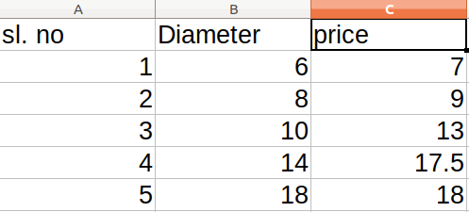
Starting With a Simple Example:-
For Example, you have data on cake sizes and their costs :

Slide 18
We can easily predict the price of a “cake” given the diameter :
# program to predict the price of cake using a linear regression technique
from sklearn.linear_model import LinearRegression
import numpy as np
# Step 1: Training data
x=[[6],[8],[10],[14],[18]] # cake size (diameter) in inches
y=[[7],[9],[13],[17.5],[18]] # cake price in dollars
# step 2: Create and fit the model
model = LinearRegression()
model.fit(x,y)
size=int(input('Enter the size of the cake: '))
#step 3: make a prediction
print(f'The price of a {size}" cake would be ${model.predict(np.array([size]).reshape(1,-1))[0][0]:.02f}')

Slide 19
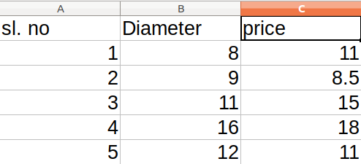
To Evaluate the model and find the fitness of the model:
To find out, that how good the prediction is,
you use the following test data set

Slide 20
And use the following code :
## r-square using scikit learn
x_test=[8,9,11,16,12] # test
y_test=[11,8.5,15,18,11] # test
x=[[6],[8],[10],[14],[18]] # cake size (diameter) in inches
y=[[7],[9],[13],[17.5],[18]] # cake price in dollars
model= LinearRegression()
model.fit(x,y)
r_square_value=model.score(np.array(x_test).reshape(-1,1),np.array(y_test).reshape(-1,1))
print(f'r-square value from Linear Regression: {r_square_value}')

Slide 21
And the output is:

Slide 22
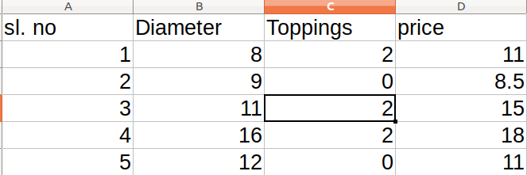
Multiple Linear Regression
But suppose the cake price depends on the size of the toppings as well as the size of the cake! Then you will have to use:

Slide 23
And Use the following code to plot a graph against the training data set:
import matplotlib.pyplot as plt
from sklearn.linear_model import LinearRegression
x1=[[6,2],[8,1],[10,0],[14,2],[18,0]] # cake size (diameter) in inches
y=[[7],[9],[13],[17.5],[18]] # cake price in dollars
model= LinearRegression()
model.fit(x1,y)
x1_test=[[8,2],[9,0],[11,2],[16,2],[12,0]]
y_test=[[11],[8.5],[15],[18],[11]]
f=plt.figure()

Slide 24
Continue
ax=f.add_subplot(111)
plt.xlabel('cake size and toppings')
plt.ylabel('cake price')
predictions = model.predict(x1_test)
v1,v2=[],[]
for i,prediction in enumerate(predictions):
print(f'predicted value : {prediction[0]:.02f} vs target value: {y_test[i][0]}')
v1.append(prediction[0])
v2.append(y_test[i][0])
print(f'R-squared : {model.score(x1_test,y_test)}')
ax.plot(v1,color='g',linestyle='--')

Slide 25
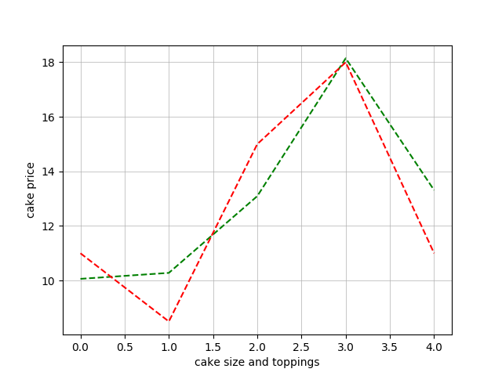
you’ll get this graph :

Slide 26
Summary:
So far you have learned about predicting data sets that are linearly related to some of the features.

Slide 27
Now you’ll learn how to Extract Features from Images and Pre-process data.
# extracting points of interest from an image
# import os
import numpy as np
from skimage.feature import corner_harris,corner_peaks
from skimage.color import rgb2gray
import matplotlib.pyplot as plt
import skimage.io as io
from skimage.exposure import equalize_hist
def view_corners(corners,image):
f = plt.figure()

Slide 28
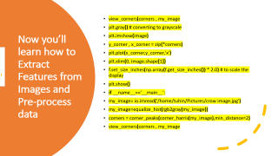
Now you’ll learn how to Extract Features from Images and Pre-process data
view_corners(corners , my_image
plt.gray() # converting to grayscale
plt.imshow(image)
y_corner , x_corner = zip(*corners)
plt.plot(x_corner,y_corner,'x')
plt.xlim(0, image.shape[1])
f.set_size_inches(np.array(f.get_size_inches()) * 2.0) # to scale the display
plt.show()
if __name__=='__main__':
my_image= io.imread('/home/tuhin/Pictures/crow image.jpg')
my_image=equalize_hist(rgb2gray(my_image))
corners = corner_peaks(corner_harris(my_image),min_distance=2)
view_corners(corners , my_image

Slide 29
Now you’ll learn how to Extract Features from Images and Pre-process data
plt.gray() # converting to grayscale
plt.imshow(image)
y_corner , x_corner = zip(*corners)
plt.plot(x_corner,y_corner,'x')
plt.xlim(0, image.shape[1])
f.set_size_inches(np.array(f.get_size_inches()) * 2.0) # to scale the display
plt.show()
if __name__=='__main__':
my_image= io.imread('/home/tuhin/Pictures/crow image.jpg')
my_image=equalize_hist(rgb2gray(my_image))
corners = corner_peaks(corner_harris(my_image),min_distance=2)

